Slide 1
Consensus Algorithms

Slide 2




Consensus Algorithms: Byzantine Generals

Slide 3

Consensus Algorithms: Byzantine Generals

Slide 4
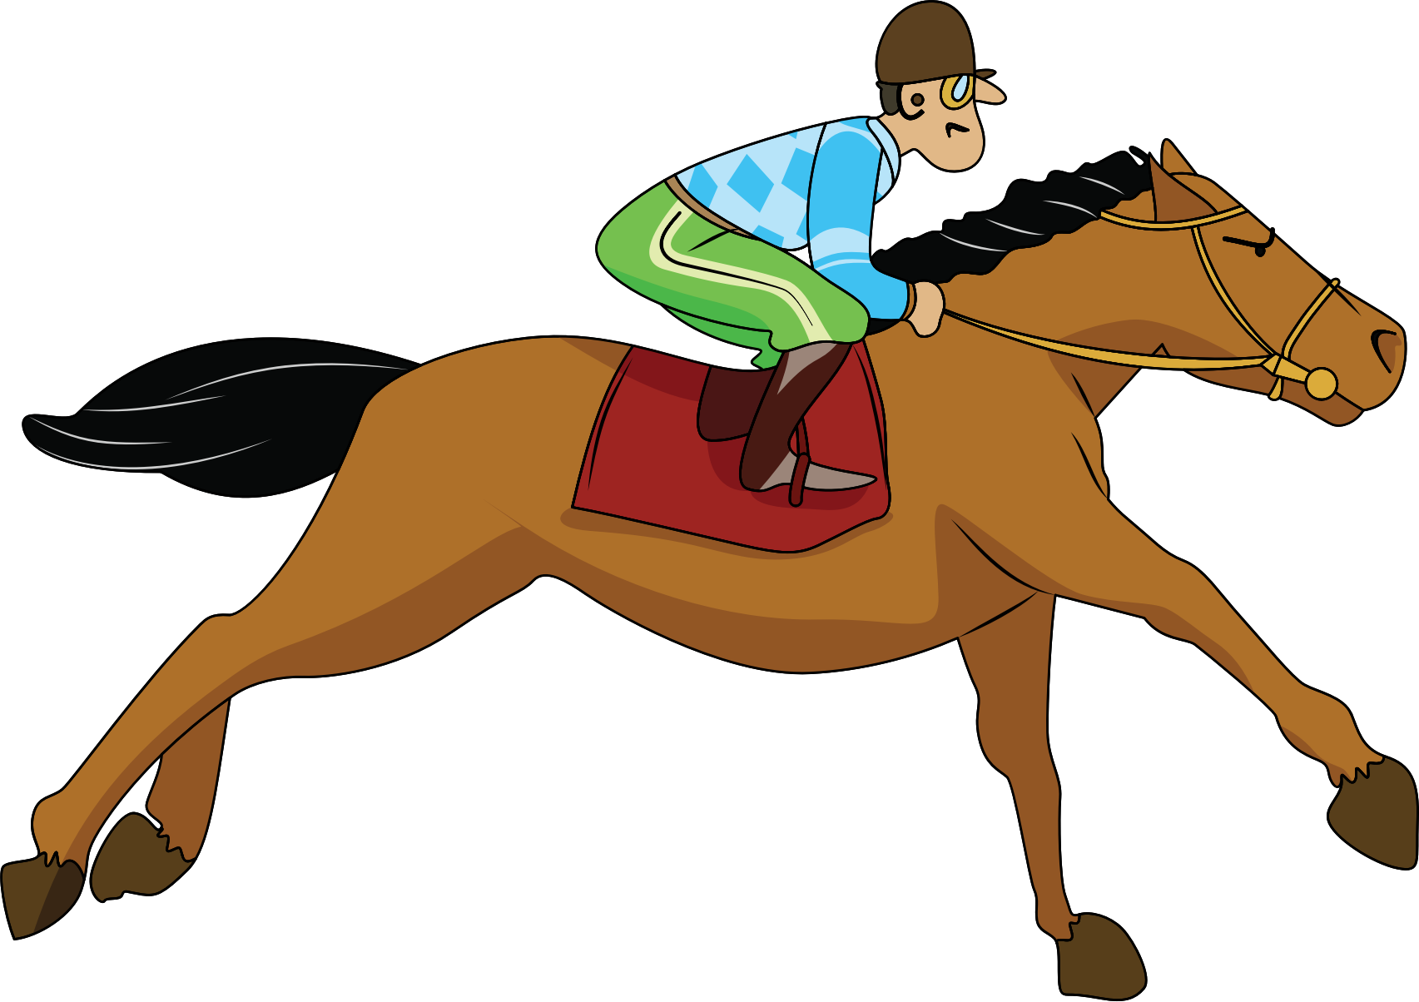
Consensus Algorithms: Byzantine Generals
Key Question: How do we coordinate with all the other generals at once?
Assume we can’t send signals the enemy can see (like torches)
We’re going to have to send messengers

Slide 5
Consensus Algorithms: Byzantine Generals
What issues might we have?
How do we know the messengers made it?
How do we know that the message wasn’t intercepted and replaced?
Same for the response
How do we know that the generals will even go along with the plan?

Slide 6
Consensus Algorithms: Byzantine Generals
How does this relate to Computer Science?
Replace generals with computers and messengers with network packets

Slide 7

Consensus Algorithms: Byzantine Generals
How does this relate to Computer Science?
Replace generals with computers and messengers with network packets

Slide 8
Consensus Algorithms: Byzantine Generals
What issues might we have?
How do we know the packets made it?
Networking (TCP)
How do we know that the packet wasn’t intercepted and replaced?
Encryption, Digital Signatures, etc.
How do we know that the other computers aren’t working against us?

Slide 9
Proof of Work

Slide 10
Proof of Work: Cryptographic Hashing
Requirements for a good cryptographic hash:
Deterministic (i.e. a given input will always result in the same output)
Computationally infeasible to generate the input from the output
Small changes to input should result in big (random-looking) changes to output (the outputs should not appear correlated in any way)
Computationally infeasible to create two inputs with the same output
Ideally, fast to compute

Slide 11
Proof of Work
Alice
Bob
Charlie
Deborah
Notes:
OK so remember that our $CornellCoin$ crypotocurrency is a distributed ledger; there’s no single centralized ledger that serves as the source of truth. Instead, everyone keeps their own version of the ledger… but how can we ensure that everyone’s ledger is the same? Any individual in the system will want to make sure that they both (1) don’t miss any ledger updates broadcast by others, and (2) have some assurance that everyone else has recorded the ledger updates that they have broadcast out. So what’s the idea with this algorithm?

Slide 12
Proof of Work
BIG IDEA: trust the ledger that has had the most “work” into it.
What do we mean by work? Hashing!
Notes:
So the big idea is that we’re going to trust the person who has put the most “work” into ledger updates. When we say “work” in this context, we’re referring to a very particular challenge.

Slide 13
Proof of Work
Alice owes Bob 100CC
Bob owes Charlie 80CC
Miner
Alice
Bob
Miner
Alice owes Charlie 500CC
Bob owes Deborah 30CC
Charlie
Deborah
Miner

Slide 14
Proof of Work
N = 10
Alice owes Bob 100CC
SHA-256
000111010100111000101000010100100100100001010010100000011111111100110….
Bob owes Charlie 80CC
Bob owes Deborah 30CC
Alice owes Charlie 500CC
Miner
16784
Notes:
Recall from our earlier discussions about cryptographic hashes that they have the property that although the output is deterministic it’s also seemingly random. In other words, there’s no way to reverse the output of a hash into the corresponding input, and the only way to generate a particular output is to just brute force inputs until you get what you want.
We’re going to use this to our advantage. The idea is we’re going to challenge participants to take a few transactions (to be clear: not the whole ledger, just the most recent few) and find some number that can be appended to the ledger such that when the block+number is hashed the output is less than some certain threshold. Equivalently, you can think of the problem as finding a hash where the binary representation of the output starts with at least a certain number of 0’s (remember hashes have a fixed bit length, so this makes sense -- in this case we’re using 256). This handful of transactions + special number is a “block”.
So let’s say the miner wants to broadcast her block out to everyone. First, she has to complete this challenge. We’ll talk more later about how we should set the challenge threshold, but for now let’s say for $CornellCoin$ we set our challenge to hash the transactions + special number to a hash that starts with at least 10 0’s.
Since by design the miner has no better strategy than just guessing, she decides to just start with 16784. Bummer, that only starts with 3 0’s.

Slide 15
Proof of Work
N = 10
Alice owes Bob 100CC
SHA-256
0111010011111111111111110010100000010101110101000000101001010….
Bob owes Charlie 80CC
Bob owes Deborah 30CC
Alice owes Charlie 500CC
Miner
46816
Notes:
She tries again with another number… bummer this is only one 0.

Slide 16
Proof of Work
N = 10
Alice owes Bob 100CC
SHA-256
00000000000011100101111010101001010100000010101110101000000101001010….
Bob owes Charlie 80CC
Bob owes Deborah 30CC
Alice owes Charlie 500CC
Miner
37212
Notes:
OK third times a charm! The miner gets lucky and finds a number that hashes everything to a number that starts with more than 10 0’s. Great!
Now notice that this number 37212 effectively serves as “proof” that the miner has put in the work towards generating the number. When the miner broadcasts her handful of transactions here, she will broadcast that special number along with them. That way, everyone who hears the broadcast can run the SHA-256 hash themselves and quickly verify that the hash does in fact pass the challenge and start with enough 0’s. Since they all know that the miner had no better strategy than guessing numbers, they know that she must’ve put in the work to generate that valid special number.

Slide 17
Proof of Work
Alice
Bob
Alice owes Bob 100CC
Bob owes Charlie 80CC
Bob owes Deborah 30CC
Alice owes Charlie 500CC
Miner
37212
Charlie
Deborah

Slide 18
Proof of Work
Alice owes Bob 100CC
Alice
Bob
Bob owes Charlie 80CC
Alice owes Bob 100CC
Bob owes Deborah 30CC
Bob owes Charlie 80CC
Alice owes Charlie 500CC
Bob owes Deborah 30CC
Alice owes Charlie 500CC
37212
Miner
37212
SHA-256
00000000000011100101111010101001010100000010101110101000000101001010….
N = 10

Slide 19
Proof of Work
What’s in it for the Miner?
Miner receives 50CC
Alice owes Bob 100CC
Bob owes Charlie 80CC
Bob owes Deborah 30CC
Alice owes Charlie 500CC
Miner

Slide 20
Proof of Work
How can Alice make sure her transaction makes it in?
Miner
Alice owes Bob 100CC
Alice tips Miner 5CC
Miner
Alice
Miner

Slide 21
Proof of Work
How can Alice make sure her transaction makes it in?
Miner receives 50CC
Alice owes Bob 100CC
+5CC
Bob owes Charlie 80CC
+2CC
Bob owes Deborah 30CC
+3CC
Alice owes Charlie 500CC
+5CC
Miner

Slide 22
Proof of Work
How does Alice know she hasn’t missed anything?
Alice owes Bob 100CC
Alice
Bob
Bob owes Charlie 80CC
Bob owes Deborah 30CC
Alice owes Charlie 500CC
Alice owes Bob 100CC
37212
Bob owes Charlie 80CC
Bob owes Deborah 30CC
Alice owes Charlie 500CC
SHA-256
Miner
37212
00000000000011100101111010101001010100000010101110101000000101001010….
N = 10

Slide 23
Proof of Work
SHA-256
SHA-256
SHA-256
Eve owes Fred 20CC
Alice owes Bob 100CC
Fred owes Gina 123CC
Bob owes Charlie 80CC
...
Fred ows Harold 10CC
Bob owes Deborah 30CC
Gina owes Eve 500CC
Alice owes Charlie 500CC
01482
37212
???
BLOCKCHAIN

Slide 24
Proof of Work
75245
Alice
Eve owes Fred 20CC
Fred owes Gina 123CC
83332
Fred ows Harold 10CC
Gina owes Eve 500CC
Alice owes Bob 100CC
Bob owes Charlie 80CC
01482
Bob owes Deborah 30CC
Alice owes Charlie 500CC
SHA-256
Miner
37212
83332

Slide 25
Proof of Work
83332
Alice
Alice owes Bob 100CC
Bob owes Charlie 80CC
83332
Bob owes Deborah 30CC
Alice owes Charlie 500CC
Alice owes Bob 100CC
Bob owes Charlie 80CC
37212
Bob owes Deborah 30CC
Alice owes Charlie 500CC
SHA-256
Miner
37212
00000000000011100101111010101001010100000010101110101000000101001010….
N = 10

Slide 26
Proof of Work
Miner
83332
Alice
Bob
Alice owes Bob 100CC
Bob owes Charlie 80CC
Bob owes Deborah 30CC
Alice owes Charlie 500CC
Miner
37212
Miner
Charlie
Deborah
Miner

Slide 27
Proof of Work
What if Alice hears two different Miners at the same time?
83332
83332
Alice owes Bob 100CC
Ingrid owes Jerry 10CC
Bob owes Charlie 80CC
Kevin owes Jerry 8CC
Bob owes Deborah 30CC
Alice
Lena owes Ingrid 30CC
Alice owes Charlie 500CC
Jerry owes Lena 70CC
Miner
Miner
37212
00653

Slide 28
Proof of Work
Answer: choose the longest chain
Miner
Miner

Slide 29
Proof of Work
Also protection against fraud!
(So long as you don’t have 51% of computation power)
Miner
Evil
Miner

